Slide 1

Your success is our success
API Assignments – Data Format
Funny Gorilla诙猩猩-IT培训

Slide 2
Prerequisites:
Use online Swagger Editor tool
https://editor.swagger.io/

Slide 3
REST API Design Assignment
Creating an API specification
Adding the API to Postman

Slide 4
Case Study – To do list application
We will create a specification for the API of an imaginary to-do list application. imagine that you are going to create the API for an application that can create and display items on a to-do list.
This application will allow users to create new to-do items.
It will also allow users to mark those items as complete and to make changes to the item after they have created it.
They can also delete an item that they no longer want to track.

Slide 5
Reference
Example OpenAPI
https://petstore.swagger.io/v2/swagger.json
OpenAPI Specification
https://swagger.io/docs/specification/about/

Slide 6
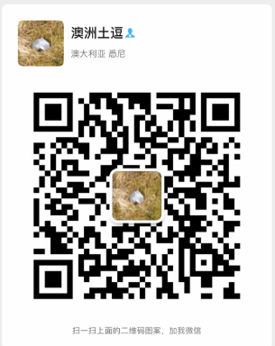
Your success is our success
Contact
Mail: info@funnygorilla.com.au
Linkedin: https://mt.linkedin.com/in/songqing-gu-2ba9034b/de
Web Chat: FunnyGorilla
Phone: 0420891343

